Slide 1
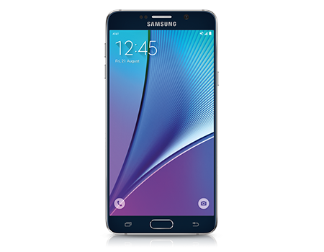
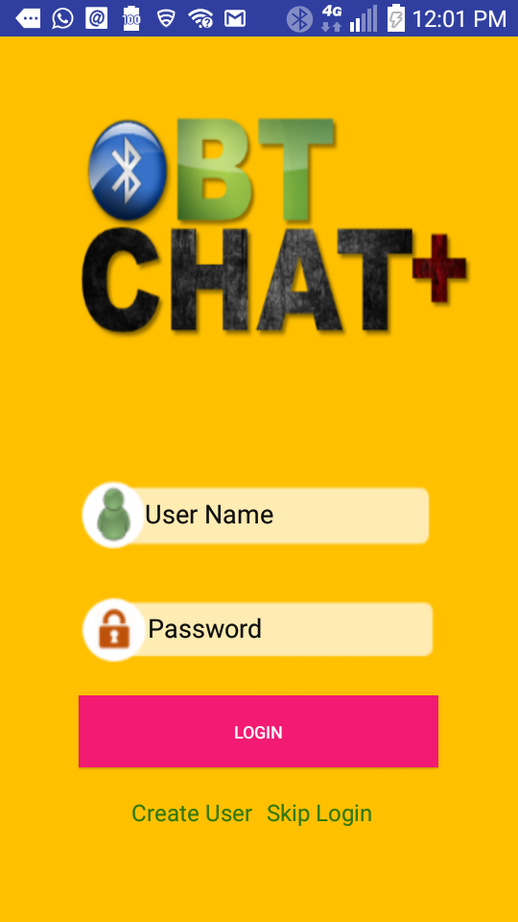
TEAM :
THANKS :
NIKHIL BRAMHANKAR
ZHIPENG HAO
LALIT PATIL
SRINIVASAN RAMARAJU
AVINASH SINGH
CHIRANJEEVI ANKAMREDDY
DIVYA KRISHNAMOORTHY

Slide 2


INTRODUCTION

Slide 3

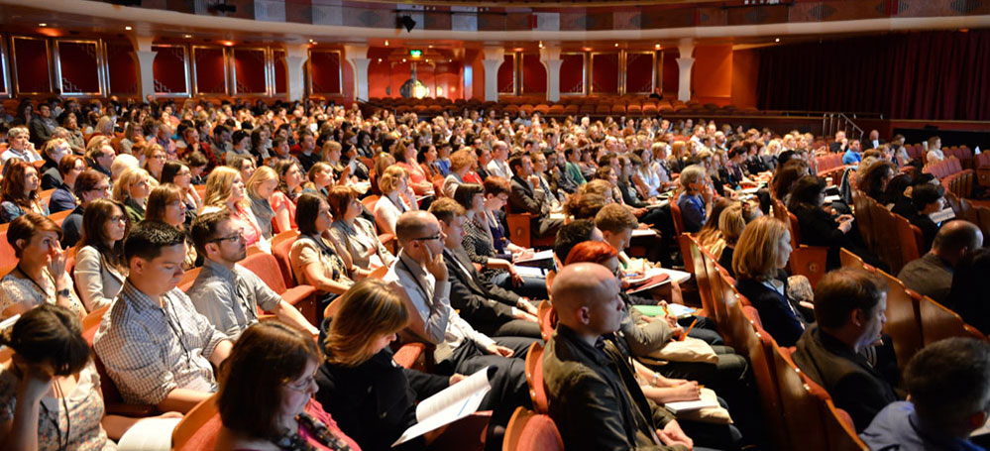
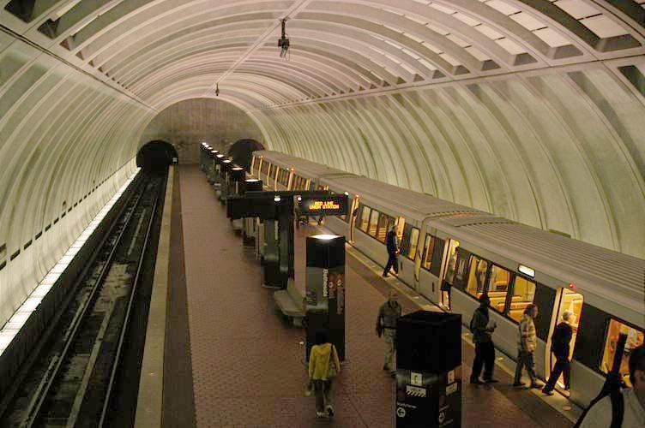
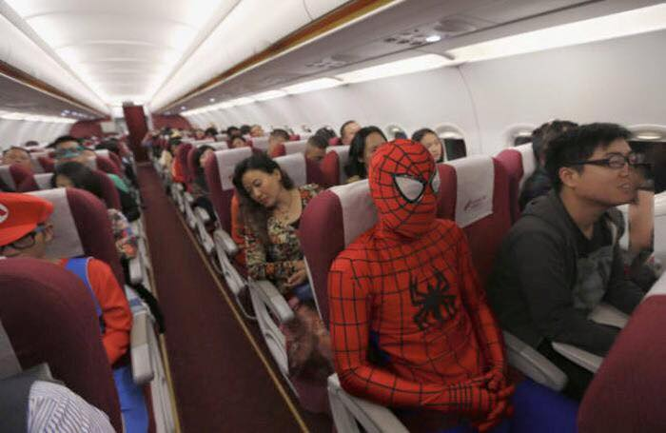
HIKING
CONFERENCE
Connect
Without
Internet
AIRPLANE
SUBWAY

Slide 4







FEATURES
Easy to navigate user interface
Transfer messages and images over Bluetooth with paired devices
History enabled chatting
User Profiling
Customizable themes
Scan for Bluetooth devices

Slide 5

WHY ARE WE BETTER?
User Friendly
Data persistence
User Profiling
Image Transfer

Slide 6

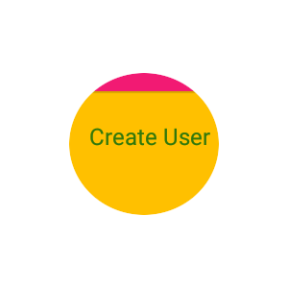
LOGIN SCREEN
Login screen provides :
login option for existing users
Create new user option
Skip login option
if you want to start using quickly, no user profile no history.
Start with creating new user, setup user!

Slide 7
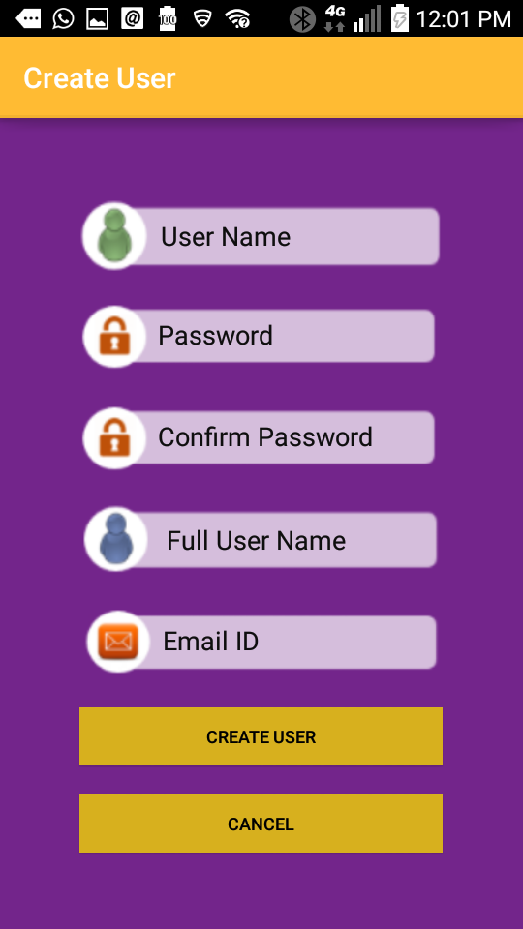
CREATE USER SCREEN
Create new user by specifying User Name, Password, Full Name and Email ID.
Validation based on type of data entered like password field, user name and email id validations.

Slide 8
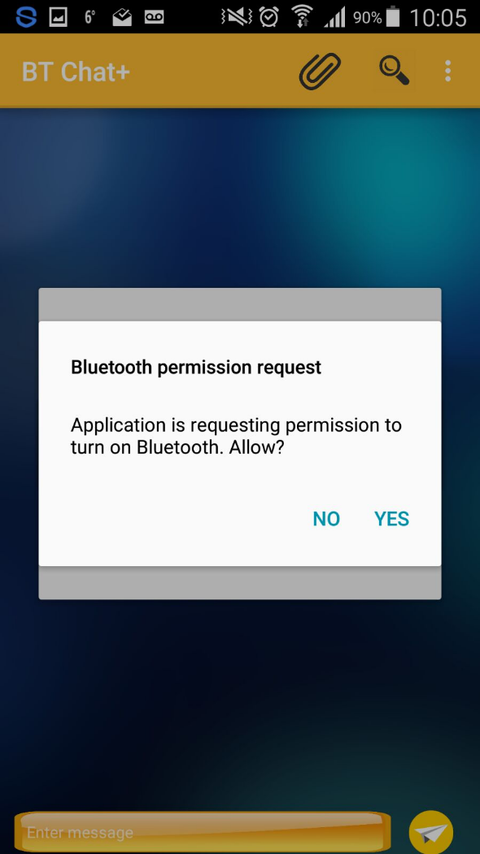
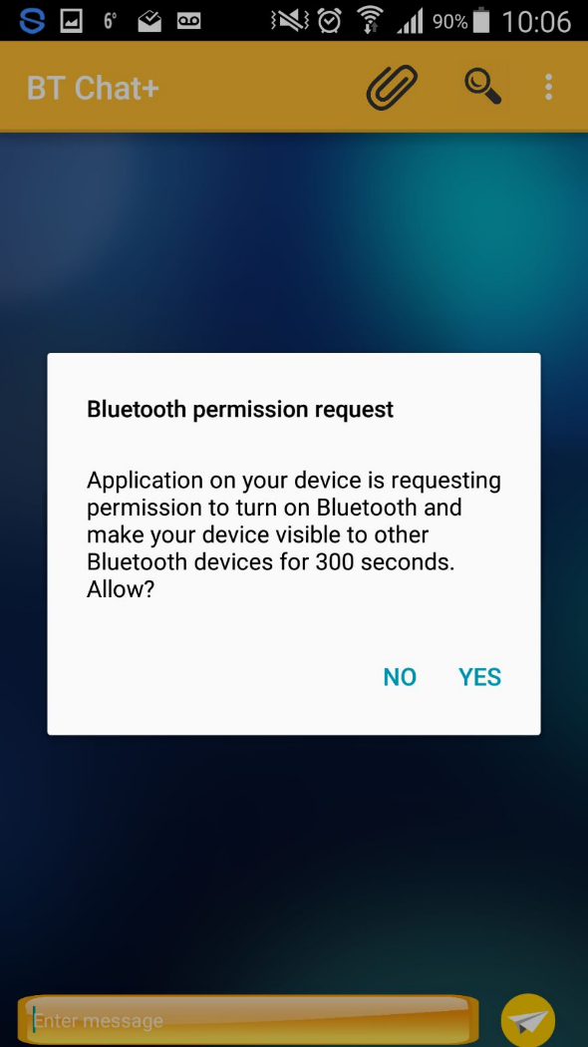
PERMISSIONS
If Bluetooth is not turned on, app will prompt user for permission to turn on Bluetooth.
Permission to make your device visible to others for 300 seconds.

Slide 9
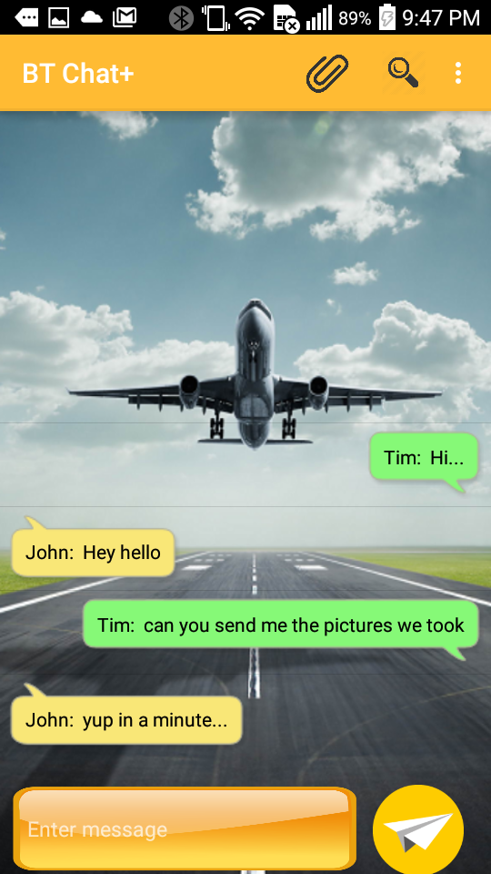
CHAT SCREEN

Slide 10


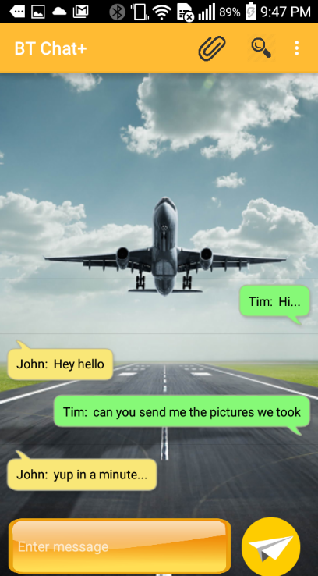
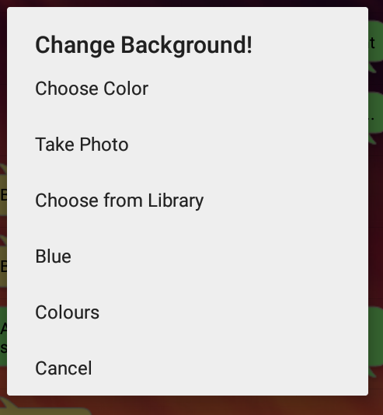

The action bar shows the app name, attach file icon, search device icon and over flow menu for settings.
Input message box takes text input as well as smileys. The send button is used to initiate send message action.
In Settings dialog, you can change background with color, image or predefined images.

Slide 11
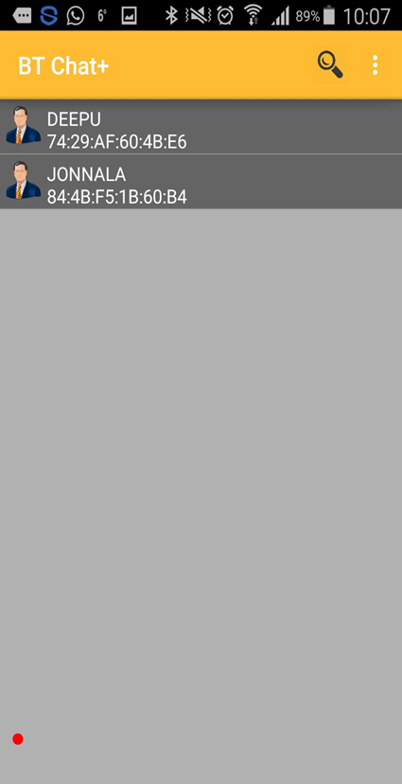
DEVICE LIST SCREEN
Device List screen lists paired devices and newly found devices around.

Slide 12



FUTURE ENHANCEMENT
+
Hybrid connectivity ( Wi-Fi + Blue tooth )
Multi user chat
Offline messages
Bluetooth Device Map

Slide 13

Find us in Google play store at
https://play.google.com/store/apps/details?id=spring16.cs442.com.obtchat_10

Slide 14
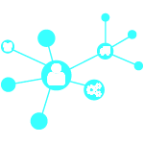


WORK DISTRIBUTION
NIKHIL BRAMHANKAR
AVINASH SINGH
Configuration management
Unit and Integration test cases
User profile module
search/pair device module
Image Transfer
Documentation
bug fixing
Configuration management
Unit and Integration test case
Login module (Partial)
Search/pair device module
Save Conversation module
Documentation
bug fixing
DIVYA KRISHNAMOORTHY
LALIT PATIL
Unit and Integration Test Cases
User Profile Module
Conversation module
Themes
Documentation
Bug Fixing
Unit and Integration test case
Login Module (Partial)
Conversation Module
Save Conversation Module
Themes
Image Transfer
Documentation
Bug Fixing

Slide 15


